Slide 1
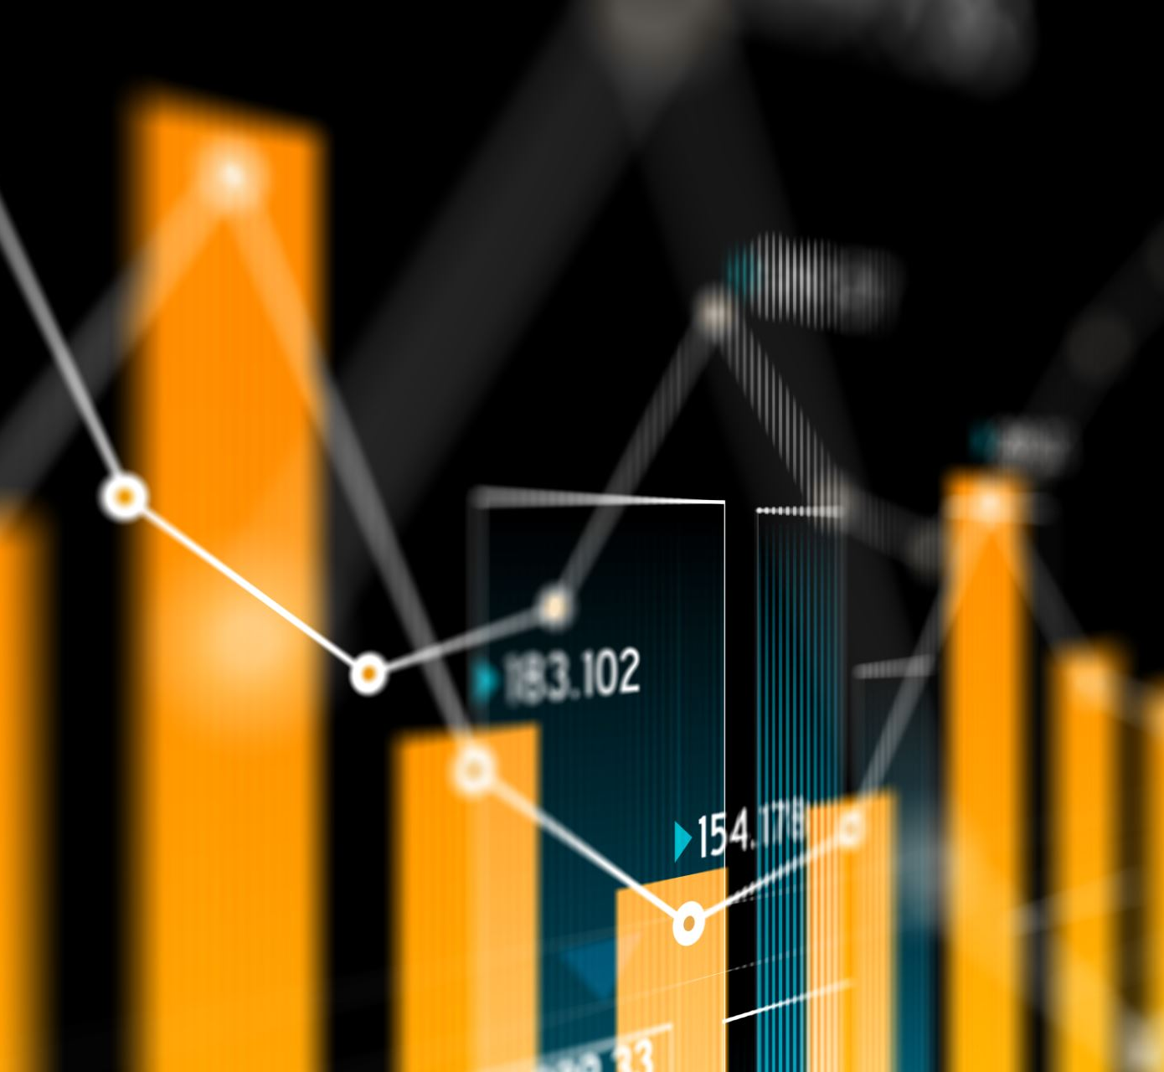
Regression and Its Visualization in Python with example
Hrishikesh Pramod Kembhavi
111907019

Slide 2
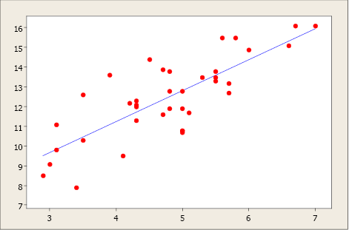
Some related terms:
Simple Linear Regression: It is a Regression Model that estimates the relationship between the independent variable and the dependent variable using a straight line [y = mx + c], where both the variables should be quantitative.
Data Visualization: It is a representation of data or information in a graph, chart, or other visual formats which is helpful to conduct analyses such as predictive analysis which can serve as helpful Visualization to present.

Slide 3
Some related terms:
Data Cleaning: It is the process of fixing or removing incorrect, corrupted, incorrectly formatted, duplicate, or incomplete data within a dataset.
Supervised Learning: The model is trained using ‘labeled data’. Datasets are said to contain labels that contain both input and output parameters. To simplify – ‘Data is already tagged with the correct answer’.
Training Model: In supervised learning, an ML Algorithm builds a model by examining many examples and attempting to find a model that minimizes loss and improves prediction accuracy.

Slide 4
In the development of the model following steps are performed:
Importing the dataset.
Visualizing the Data
Data Cleaning
Building the Model and Training it
Making Predictions on Unseen Data

Slide 5

1. Importing the Dataset:
Dataset is a collection of data pieces that can be treated by a computer as a single unit for analysis and prediction purposes.
It can be in the form of .csv or .pkl files. Here, a .pkl file has been used.
To read the contents of the file, it is necessary to import pickle module
Here , a data containing age and the height corresponding to it is taken.

Slide 6
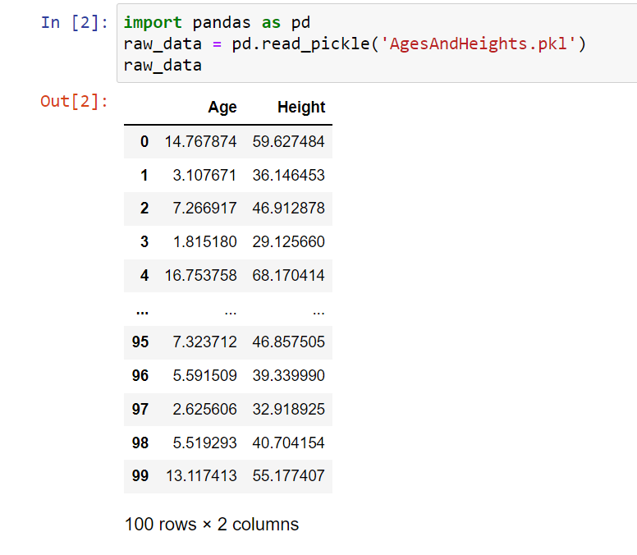
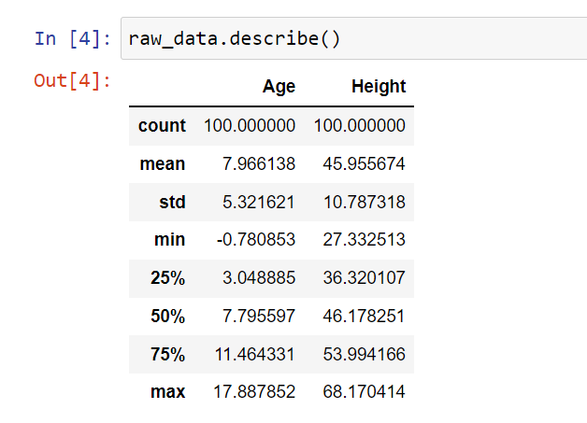
2. Visualizing the Data
Data in the given dataset can be visualized with the help of Pandas library in Python.
Using .describe() function all parameters of the given dataset can be seen.
Visualizing the data tells a lot about it, such as min, max values and justifies the need to preprocess and clean the dataset according to our requirements.

Slide 7
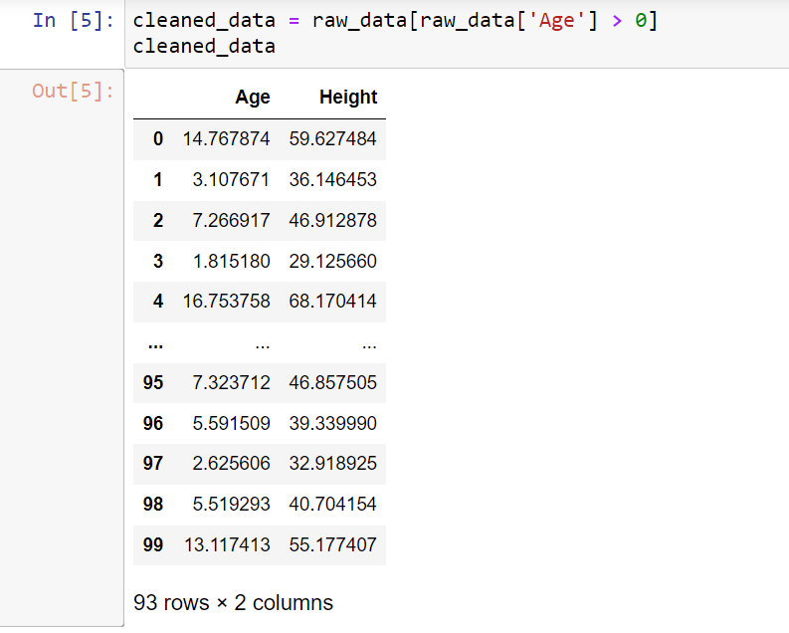
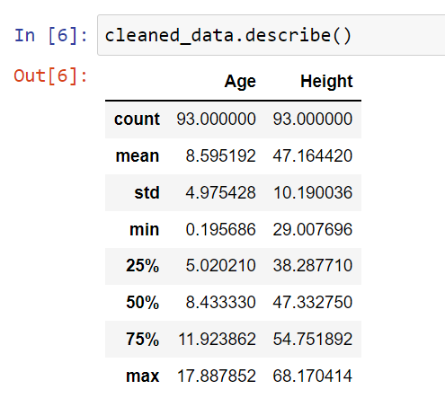
3. Data cleaning
To change the dataset according to our requirements, data cleaning is used.
Here, the negative values of age and its corresponding row has been removed form the dataset
Modified dataset can be seen here

Slide 8
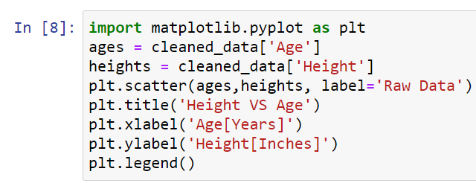
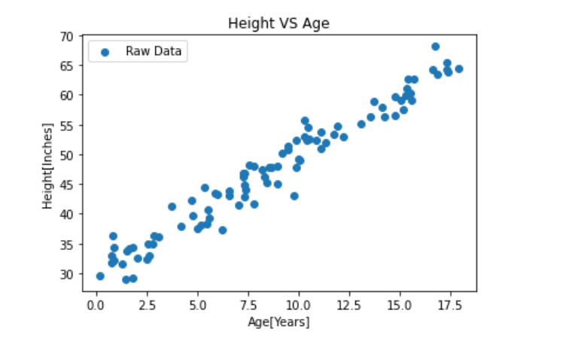
Visualizing the
Cleaned data:

Slide 9
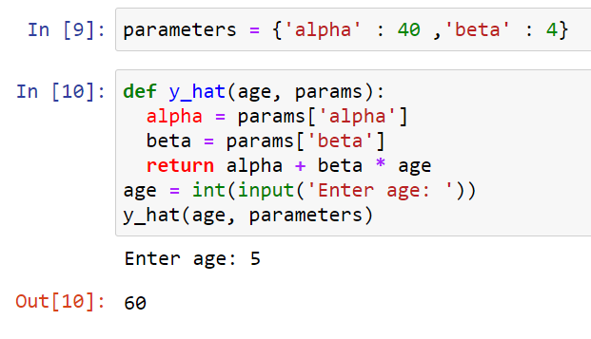
4. Building the Model and Training it:
In the linear regression model, we predict the outcome by approximating a line between the given dataset.
Here, a function to generate a line using arbitrary parameters is written.
This is an approximated function for the line .
Further in this discussion another function is written which modifies the above parameters and give us an accurate equation of the line.

Slide 10
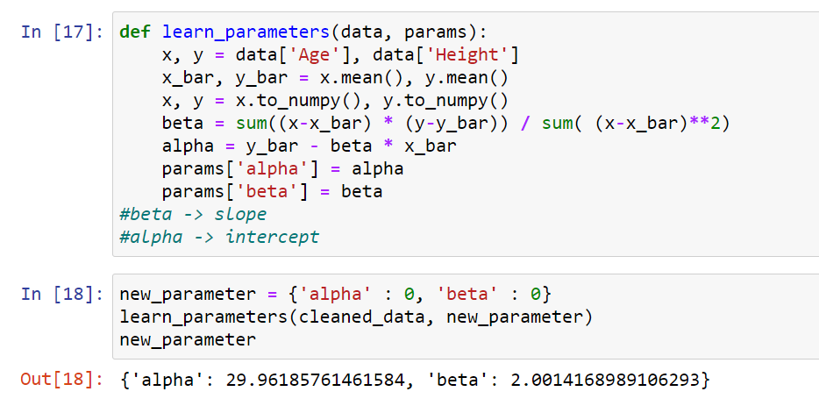
Here, a function to find accurate values of alpha and beta is used.
We use any new_parameter to generate the values of alpha and beta using the function

Slide 11
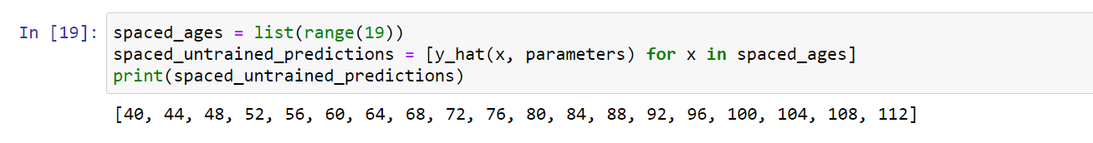
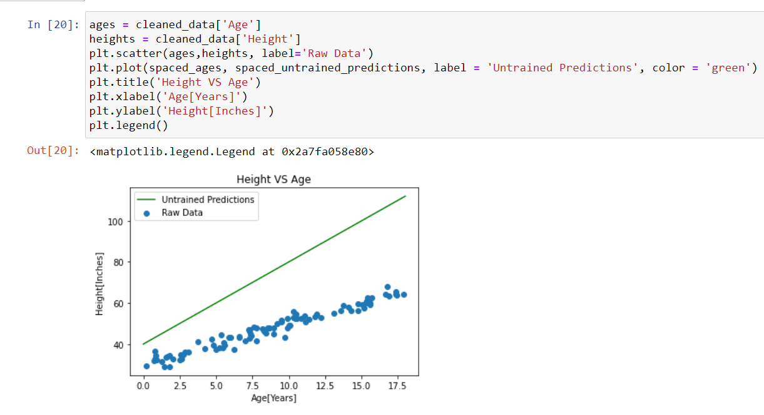
Here, a set of values upto 18 are generated for them to be plotted into the graph using the old parameters,.

Slide 12
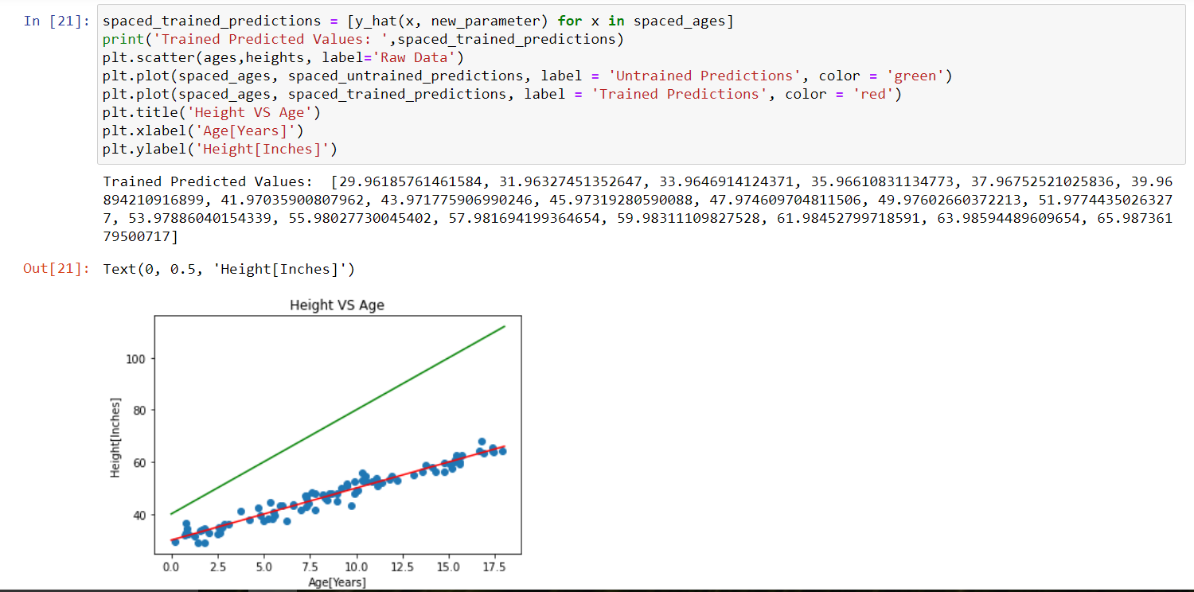
Now, using the set of values up to 18 but using the new_parameters which were modified using the function were used here
This function gives the output as red line passing through the raw data which accurately portrays the use of linear regression.

Slide 13
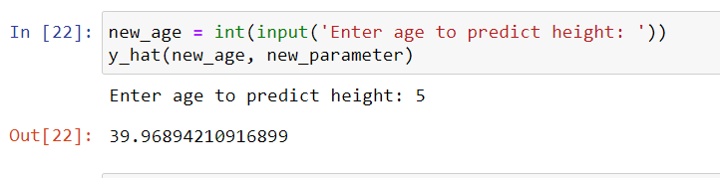
5. Making Predictions on Unseen Data:
Using the equation of the line passing through middle of the dataset , the values of heights for unknown ages can be found.

Slide 14
Conclusion:
With the help of Python, a simple machine learning algorithm of Linear Regression was implemented and visualized .
Using this algorithm, in few cases, outcome can be predicted accurately.
Similarly, many regression algorithms such as multiple regression , logistic regression can be preformed using Python.

